Slide 1
Home Price Prediction App
Author: Vijay Kumar Katta Course: DSC 670 – Advanced Uses of Generative AI

Slide 2
Problem Statement
Objective:
Estimate the market value of a residential property using its features like:
Bedrooms
Bathrooms
Lot size
Square footage
ZIP Code
Goal:
Make pricing predictions more accessible and interpretable to non-technical users using GPT-4.

Slide 3
Data Source
Dataset: USA Real Estate Dataset from Kaggle
Sample Size: 10,000 listings (Considering first 10K rows)
Columns used for modeling: bed, bath, acre_lot, house_size, zip_code, price
Preprocessing:
Dropped missing values
Selected numeric and location features

Slide 4
Machine Learning Mode
Model: Random Forest Regressor
Evaluation Metrics:
Mean Squared Error (MSE): ~349M
R² Score: ~0.46 (Moderate, can be improved)
Output: model.pkl for Streamlit integration

Slide 5
Application UI
Built using Streamlit
Users enter:
Bedroom, Bathroom, Lot size, House size, ZIP code
Instant price prediction with formatted result

Slide 6
GPT-4 Integration
Used OpenAI's GPT-4 API
Explains prediction results in plain language
Suggests home improvement options to boost value
Empowers non-technical users to make data-driven decisions

Slide 7
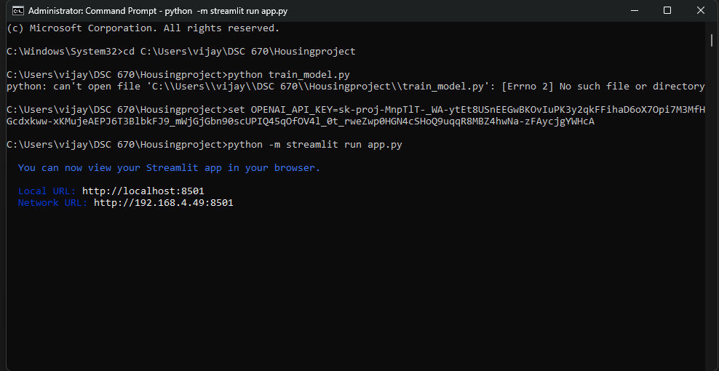
Running Screenshots

Slide 8
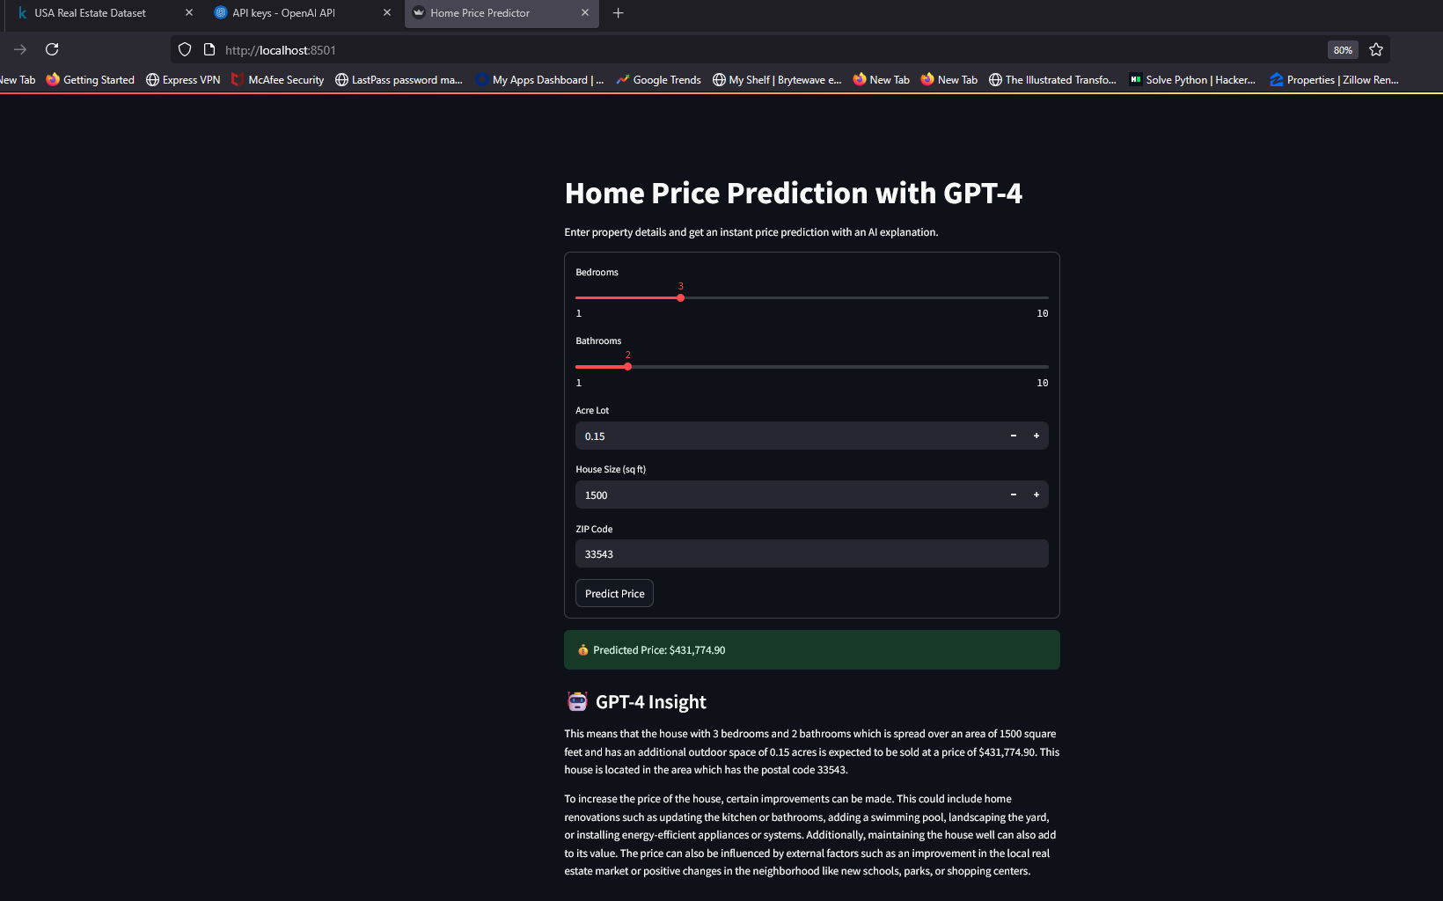

Slide 9
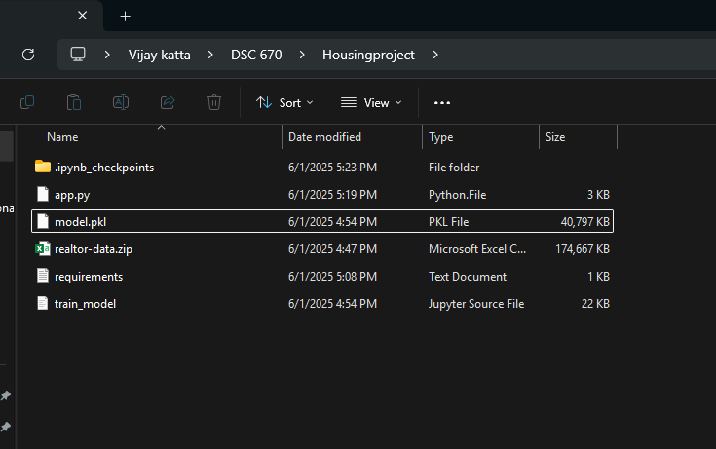

Slide 10
Thank you!

